Slide 1
Chapter 3 Tutorial: Data Preprocessing
IT323 Data Mining

Slide 2
Q 1: Use smoothing by bin means to smooth the above data, using a bin depth of 3: Age: 13, 15, 16, 16, 19, 20,20, 21, 22, 22, 25, 25, 25, 25, 30, 33, 33, 35, 35, 35, 35, 36, 40, 45, 46, 52, 70
Step 1: Sort the data.
Step 2: Partition the data into equidepth (frequency) bins of depth 3.
Bin 1: 13, 15, 16 Bin 2: 16, 19, 20 Bin 3: 20, 21, 22
Bin 4: 22, 25, 25 Bin 5: 25, 25, 30 Bin 6: 33, 33, 35
Bin 7: 35, 35, 35 Bin 8: 36, 40, 45 Bin 9: 46, 52, 70
Step 3: Calculate the arithmetic mean of each bin.
Step 4: Replace each of the values in each bin by the arithmetic mean calculated for the bin.
Bin 1: 14 2/3, 14 2/3, 14 2/3 Bin 2: 18 1/3, 18 1/3, 18 1/3 Bin 3: 21, 21, 21
Bin 4: 24, 24, 24 Bin 5: 26 2/3, 26 2/3, 26 2/3 Bin 6: 33 2/3, 33 2/3, 33 2/3
Bin 7: 35, 35, 35 Bin 8: 40 1/3, 40 1/3, 40 1/3 Bin 9: 56, 56, 56
This method smoothes a sorted data value by consulting to its ”neighborhood”. It performs local smoothing.

Slide 3

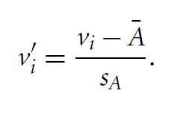
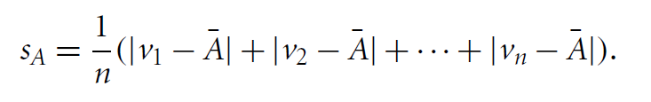


Q2: What are the value ranges of the following normalization methods?
(a) min-max normalization to [new_min, new_max]
(b) z-score normalization: (μ: mean, σ: standard deviation)
(c) z-score normalization using the mean absolute deviation SA
(d) normalization by decimal scaling
Where j is the smallest integer such that

Slide 4
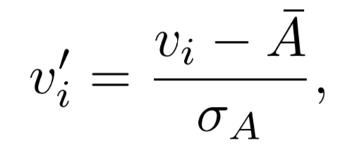
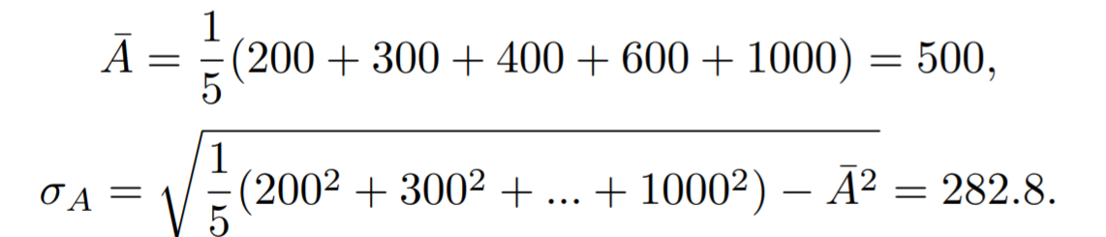
Q3: Use the methods below to normalize the following group of data: 200; 300; 400; 600; 1000
a) min-max normalization by setting min = 0 and max = 1
get the new value by computing:
The normalized data are= 0, 0.125, 0.25, 0.5, 1
b) z-score normalization
a value vi of A is normalized to v′i by computing:
The normalized data are = -1.06, -0.7, -0.35, 0.35, 1.78

Slide 5
Q3: Use the methods below to normalize the following group of data: 200; 300; 400; 600; 1000
c) z-score normalization using the mean absolute deviation instead of standard deviation
replaces with , where
The normalized data are: − 1.25, − 0.833, − 0.417, 0.417, 2.08
d) Normalization by decimal scaling
The smallest integer j such that Max(|ν’|) < 1 is 4.
After normalization by decimal scaling, the data become: 0.02, 0.03, 0.04, 0.06, 0.1

Slide 6
Q4: Age: 13, 15, 16, 16, 19, 20,20, 21, 22, 22, 25, 25, 25, 25, 30, 33, 33, 35, 35, 35, 35, 36, 40, 45, 46, 52, 70.
a) Use min-max normalization to transform the value 35 for age onto the range [0:0;1:0].
minA = 13, maxA = 70,
new minA = 0; new maxA = 1.0,
then v = 35 is transformed to v’ = 0.39.
b) Use z-score normalization to transform the value 35 for age, where the standard deviation of age is 12.94 years.
Mean = 809/27 = 29.96 and Sd= 12.94,
then v = 35 is transformed to v’ = 0.39.
c) Use normalization by decimal scaling to transform the value 35 for age.
j = 2, v = 35 is transformed to v’ = 0.35.

Slide 7
Q5: Suppose a group of 12 sales price records has been sorted as follows: 5, 10, 11, 13, 15, 35, 50, 55, 72, 92, 204, 215. Partition them into three bins by each of the following methods:
a) equal-frequency (equidepth) partitioning
Equal-depth (frequency) partitioning: It divides the range into N intervals, each containing approximately same number of samples
Partition the data into equidepth bins of depth 4:
Bin 1: 5, 10, 11, 13
Bin 2: 15, 35, 50, 55
Bin 3: 72, 92, 204, 215

Slide 8
Q5: Suppose a group of 12 sales price records has been sorted as follows: 5, 10, 11, 13, 15, 35, 50, 55, 72, 92, 204, 215. Partition them into three bins by each of the following methods:
b) equal-width partitioning
Equal-width It divides the range into N intervals of equal size
Partitioning the data into 3 equi-width bins will require the width to be (Max-Min)/N ➔ (215 − 5)/3 = 70. We get:
Bin 1: 5, 10, 11, 13, 15, 35, 50, 55, 72
Bin 2: 92
Bin 3: 204, 215

